Slide 1
CSIC5011 Final Project: Visualization Comparison on Fashion MNIST
DONG Hanze {hdongaj}, Li Donghao {dlibf}, WU Jiamin {jwubz}

Slide 2
Introduction
and
Problem Define

Slide 3
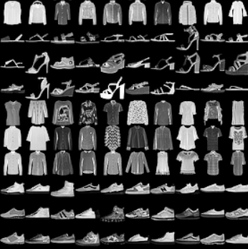
Introduction
High dimensional datasets and representations are widely used and found practical (image/language). For example, deep learning methods tend to LEARN a good representation.
High dimension data often lies on a subspace with some special structure (signal)
Visualization is quite hard for high dimensional data

Slide 4
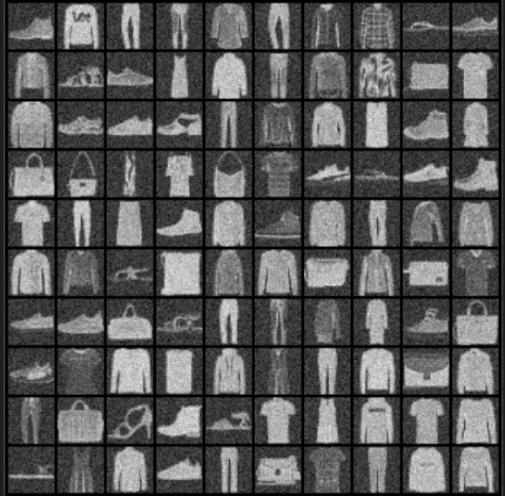
Dataset
Fashion MNIST:
Training -- 60,000 examples
Test -- 10,000 examples.
28x28 grayscale image
10 classes.
With or without N(0,0.01) noise.

Slide 5
Methods

Slide 6
Linear Methods
Random Projection: Random dimension
PCA: Eigen decomposition
LDA: Latent factor

Slide 7
Manifold based
Reduction
T-SNE: similarity between data as the joint probability. Low dimensional representation is parametrized by t-distribution.
UMAP: does not normalize joint probability and use stochastic gradient.

Slide 8
T-SNE
Define similarity between data points as probability (need normalization)
Bandwidth of similarity is normalized by entropy : sum -plogp.
Low-dim data is parametrized by t-distribution
Minimize KL-divergence by GD

Slide 9
UMAP
Define similarity without normalization s(x1,x2)<=1
Bandwidth is controlled by sum of similarity
Low-dim data is parametrized by a larger distribution class (contains t-distribution) s’(y1,y2)<=1
Minimize cross-entropy by SGD
s log s’ + (1-s) log(1-s’),
Capture low similarity pair better.

Slide 10
Bayesian Latent factor
LDA: supervised linear (z|x,y is linear structured)
VAE: unsupervised/supervised non-linear (z|x is parametrized by neural networks)
Z is latent factor of data distribution X
Find posterior Z|X

Slide 11
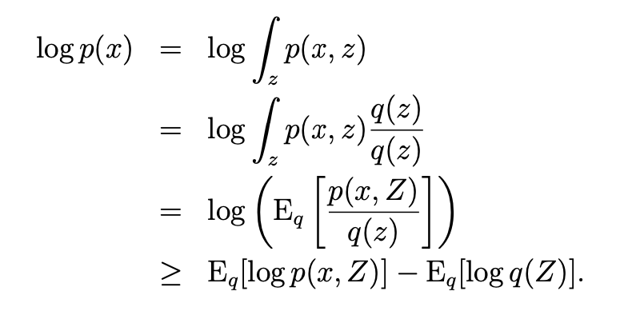
VAE
ELBO: Evidence lower bound
When split p(x,z) to p(z) and p(x|z), it becomes KL(q||p(z))+ E_q log(p(x|z))
Parametrization: q, p(x|z) is parametrized by neural network in Gaussian distribution class
Parametrize q(Z) to approximate true p(Z|X)

Slide 12
Experiments

Slide 13
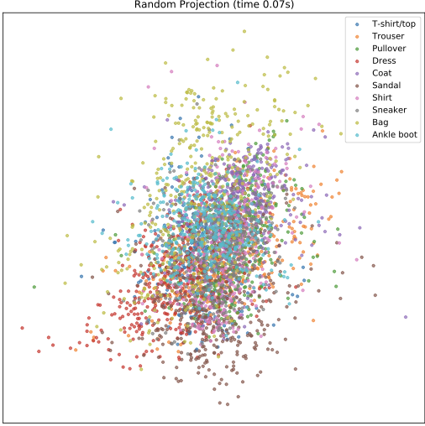
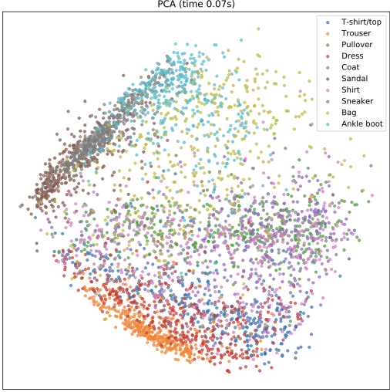
Random Projection
PCA

Slide 14
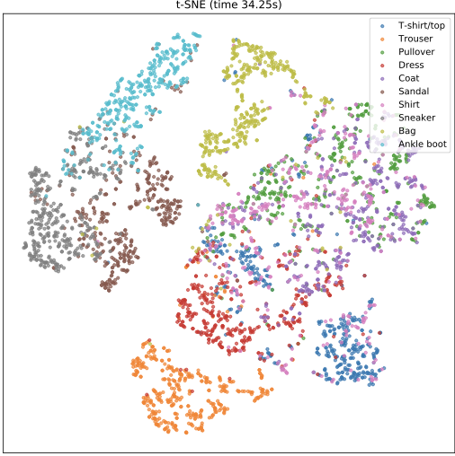
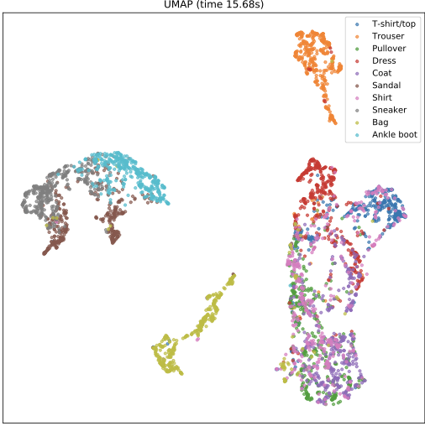
PCA
T-SNE
UMAP

Slide 15
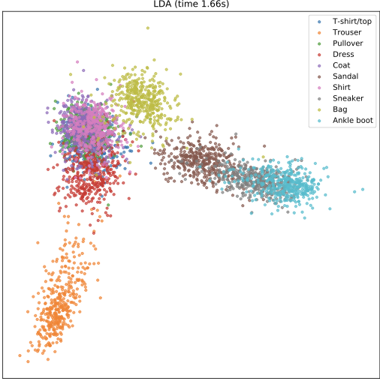
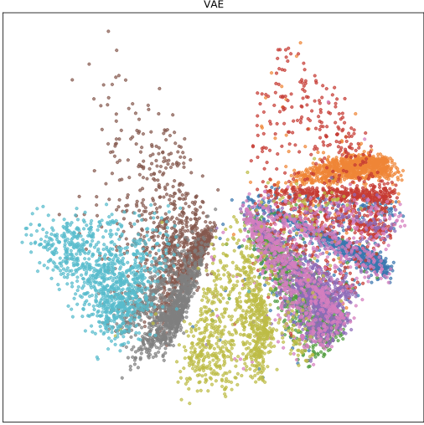
PCA
LDA
VAE

Slide 16
Result
 | RP | PCA | LDA | MDS | ISOmap | LLE | MLLE | t-sne | UMAP | DENSMAP | VAE
Run time | 0.06s | 0.05s | ~1.5s | ~35s | ~50s | ~25s | ~30s | ～35s | 14s | 17s | ~2h
parameter-tuning | No | No | No | No | k | k | k | ppl | k | k | Yes
linear svm (LS) | 27.67 | 47.62 | 61.42 | 42.72 | 54.49 | 53.95 | 53.27 | 67.00 | 66.85 | 64 | 64.1
rbf svm (RS) | 29.95 | 52.69 | 63.45 | 52.12 | 56.32 | 58.55 | 63.175 | 70.42 | 70.42 | 70.3 | 67.99
LS (noisy data) | 24.74 | 47.77 | 59.92 | 36.75 | 52.96 | 57.17 | 59.8 | 66.90 | 64.79 | 62.45
RS (noisy data) | 26.7 | 53.02 | 62.00 | 48.9.0 | 56.65 | 61.17 | 64.67 | 70.87 | 68.52 | 69.37
remark |  |  | supervised |  |  |  |  |  |  |  | large data

Slide 17
Conclusion
In general, we have compared different dimensionality reduction methods on the Fashion MNIST dataset to visualize the data distribution pattern on 2-d axis.
Manifold-based algorithms, such as T-SNE, UMAP provides the best visualization, but are relative slow.
Linear methods are fast. With supervision, LDA also provides good representation.
Latent factor model with deep learning, i.e. VAE, performs well but entails too much computation, which is suitable for large scale representation learning.

